Slide 1
AIRLINE RESERVATION
By
Sahil Joshi, Nikhitha, Jyoti Murkute, Akshay Hegde

Slide 2
Problem Statement
Today’s most of the airline website are lagging in some areas like some are not providing proper UI which could be user friendly while some are slow in processing pages or are not dynamic. Software must be developed for automating the online reservation system of airline.

Slide 3
Roles
Akshay – Registration and Login
Sahil Joshi – Ticket Booking
Jyoti Murkute – Ticket Information and Cancellation
Nikhitha – Admin Portal

Slide 4
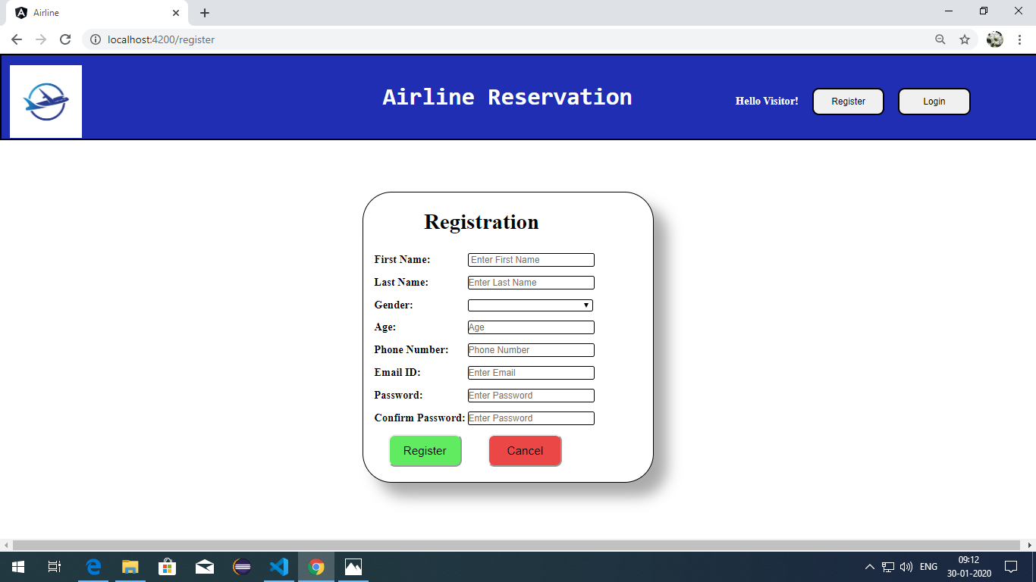
Registration Page

Slide 5
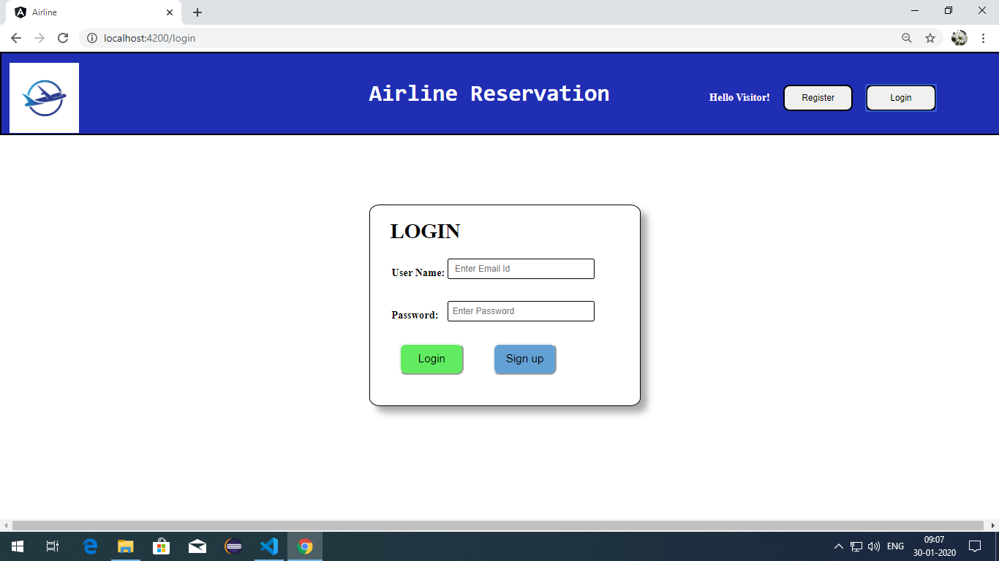
Login Page

Slide 6
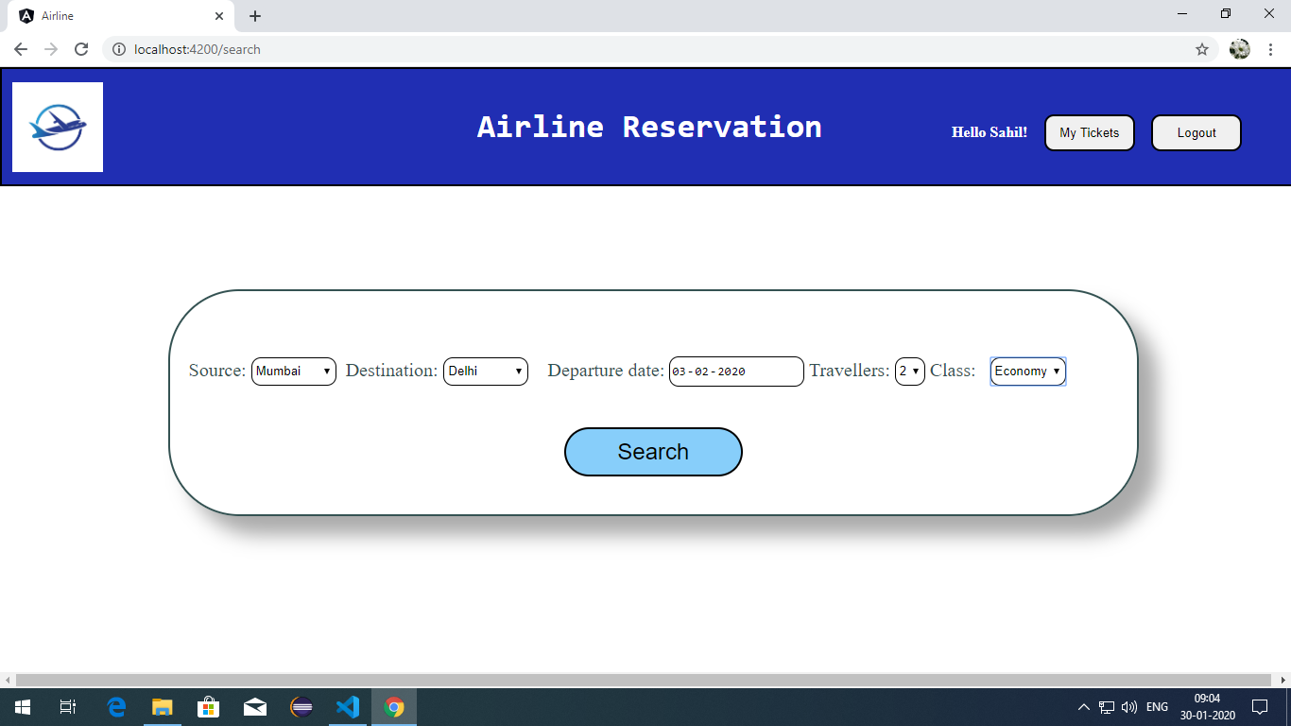
Flight Search Page

Slide 7
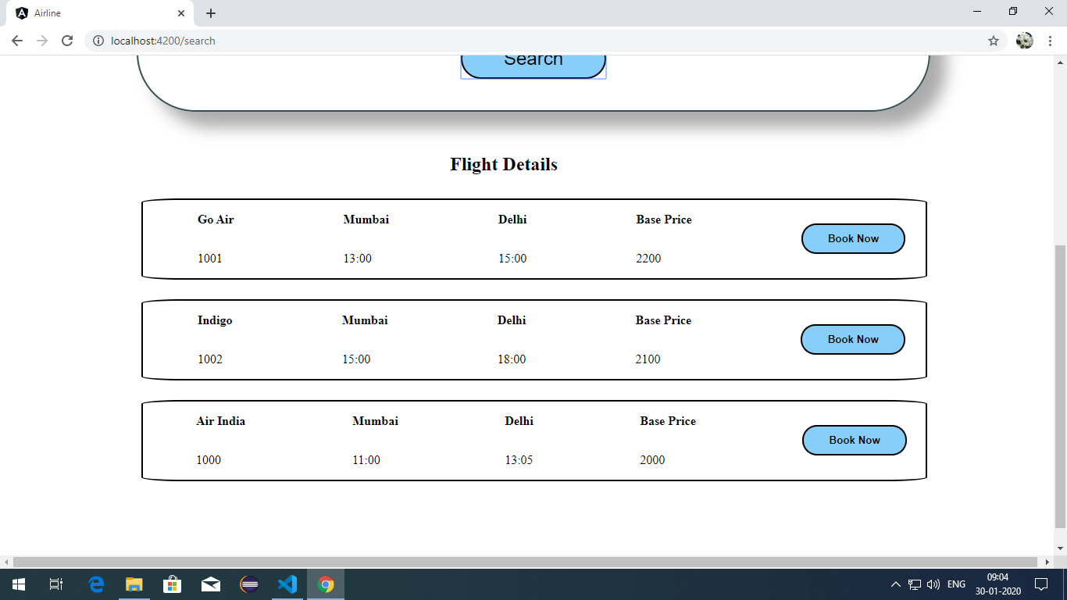
Flight Select

Slide 8
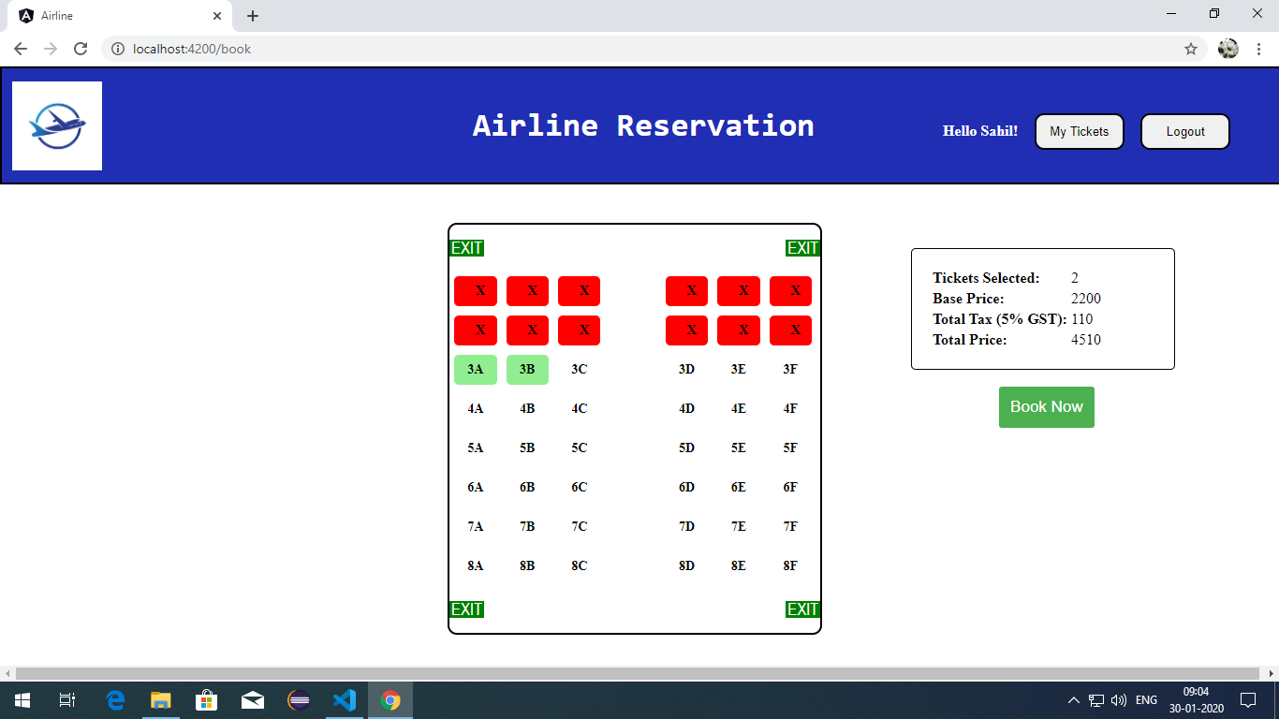
Seat Select

Slide 9
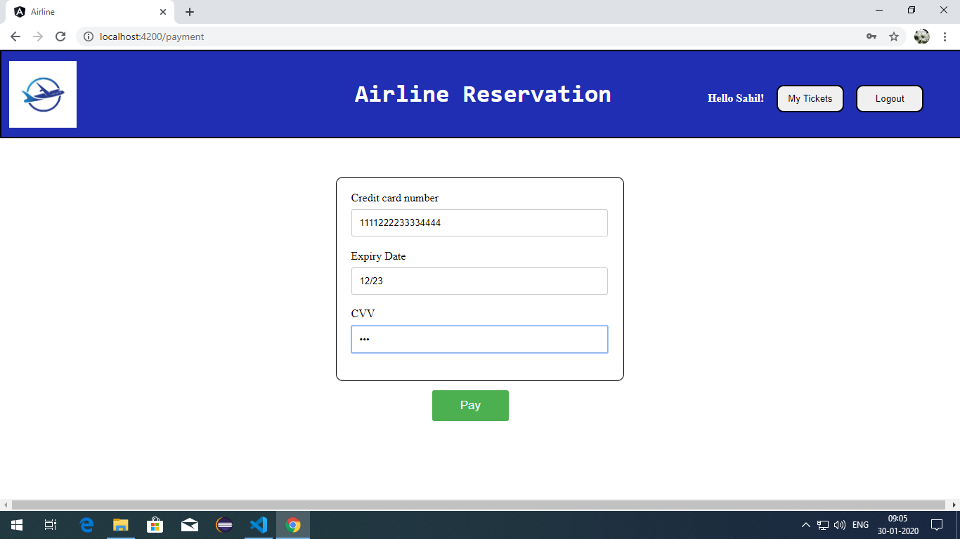
Payment Page

Slide 10
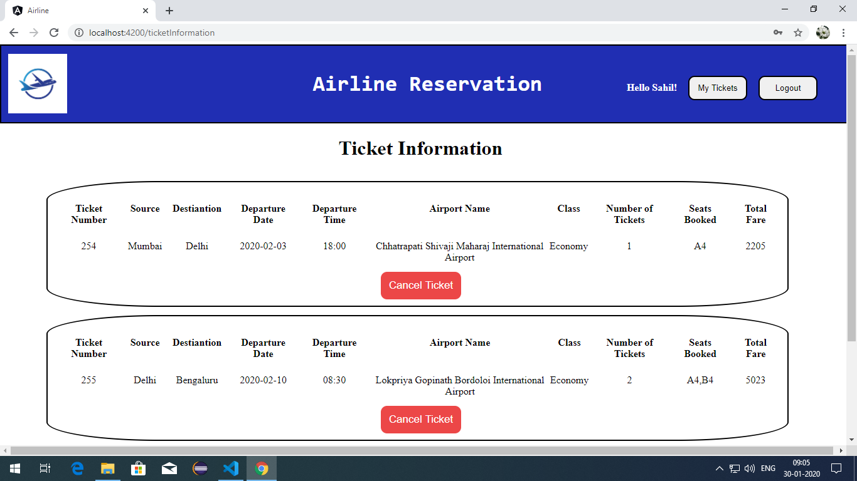
Tickets

Slide 11
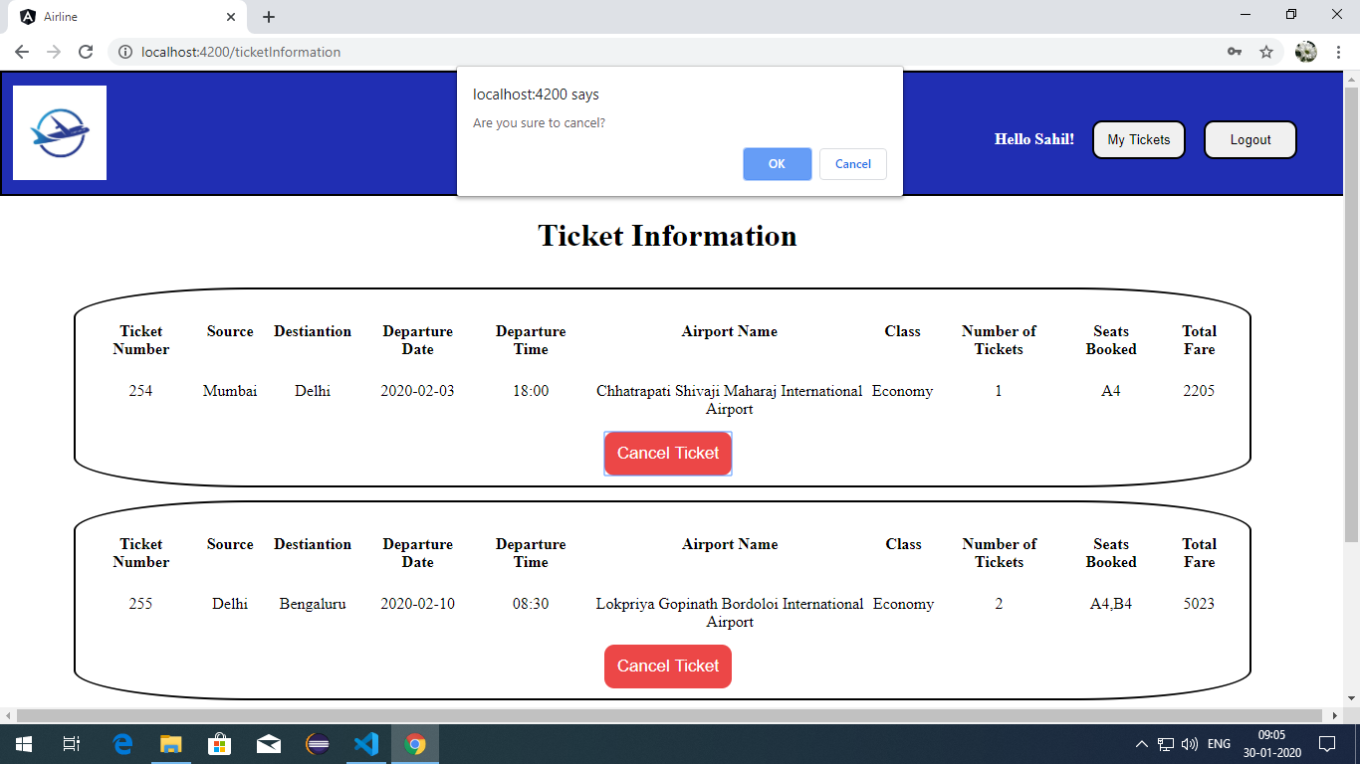
Ticket Cancellation

Slide 12
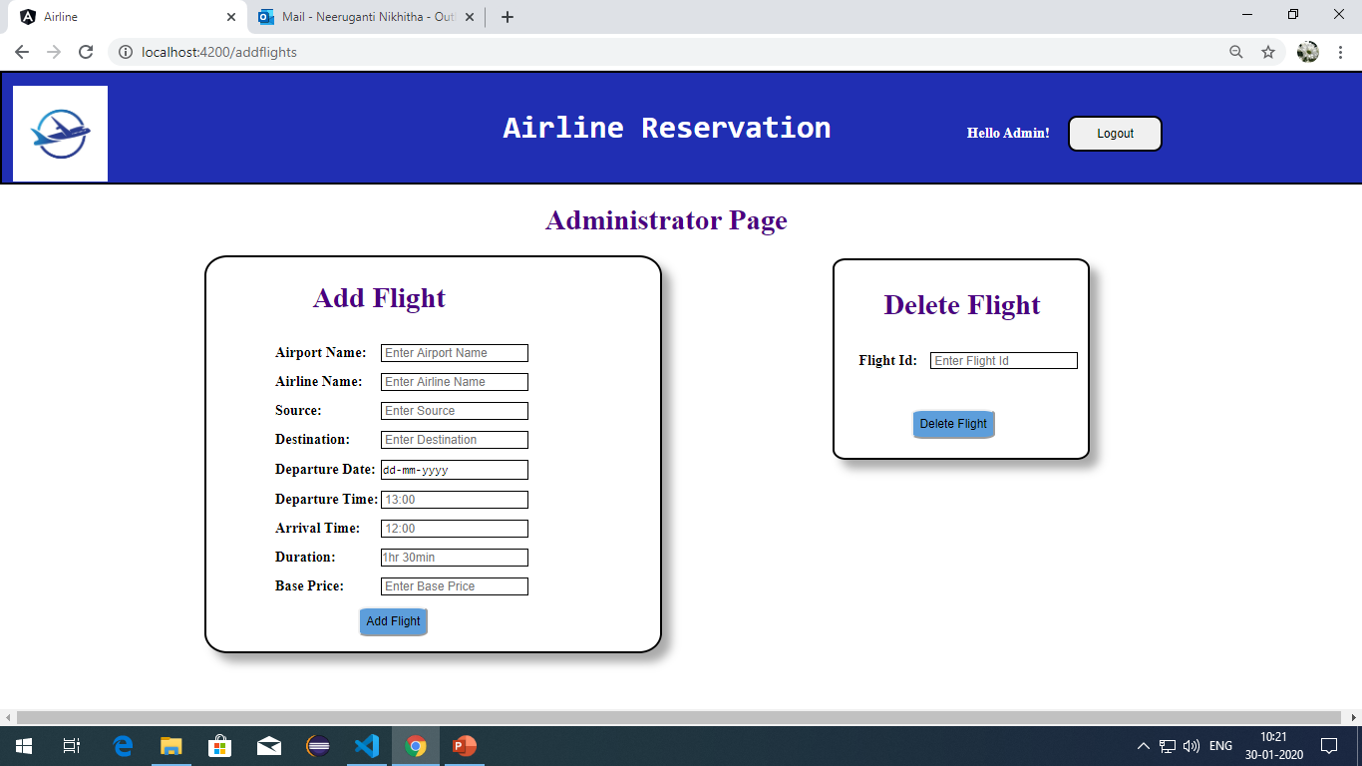
Admin Portal

Slide 13
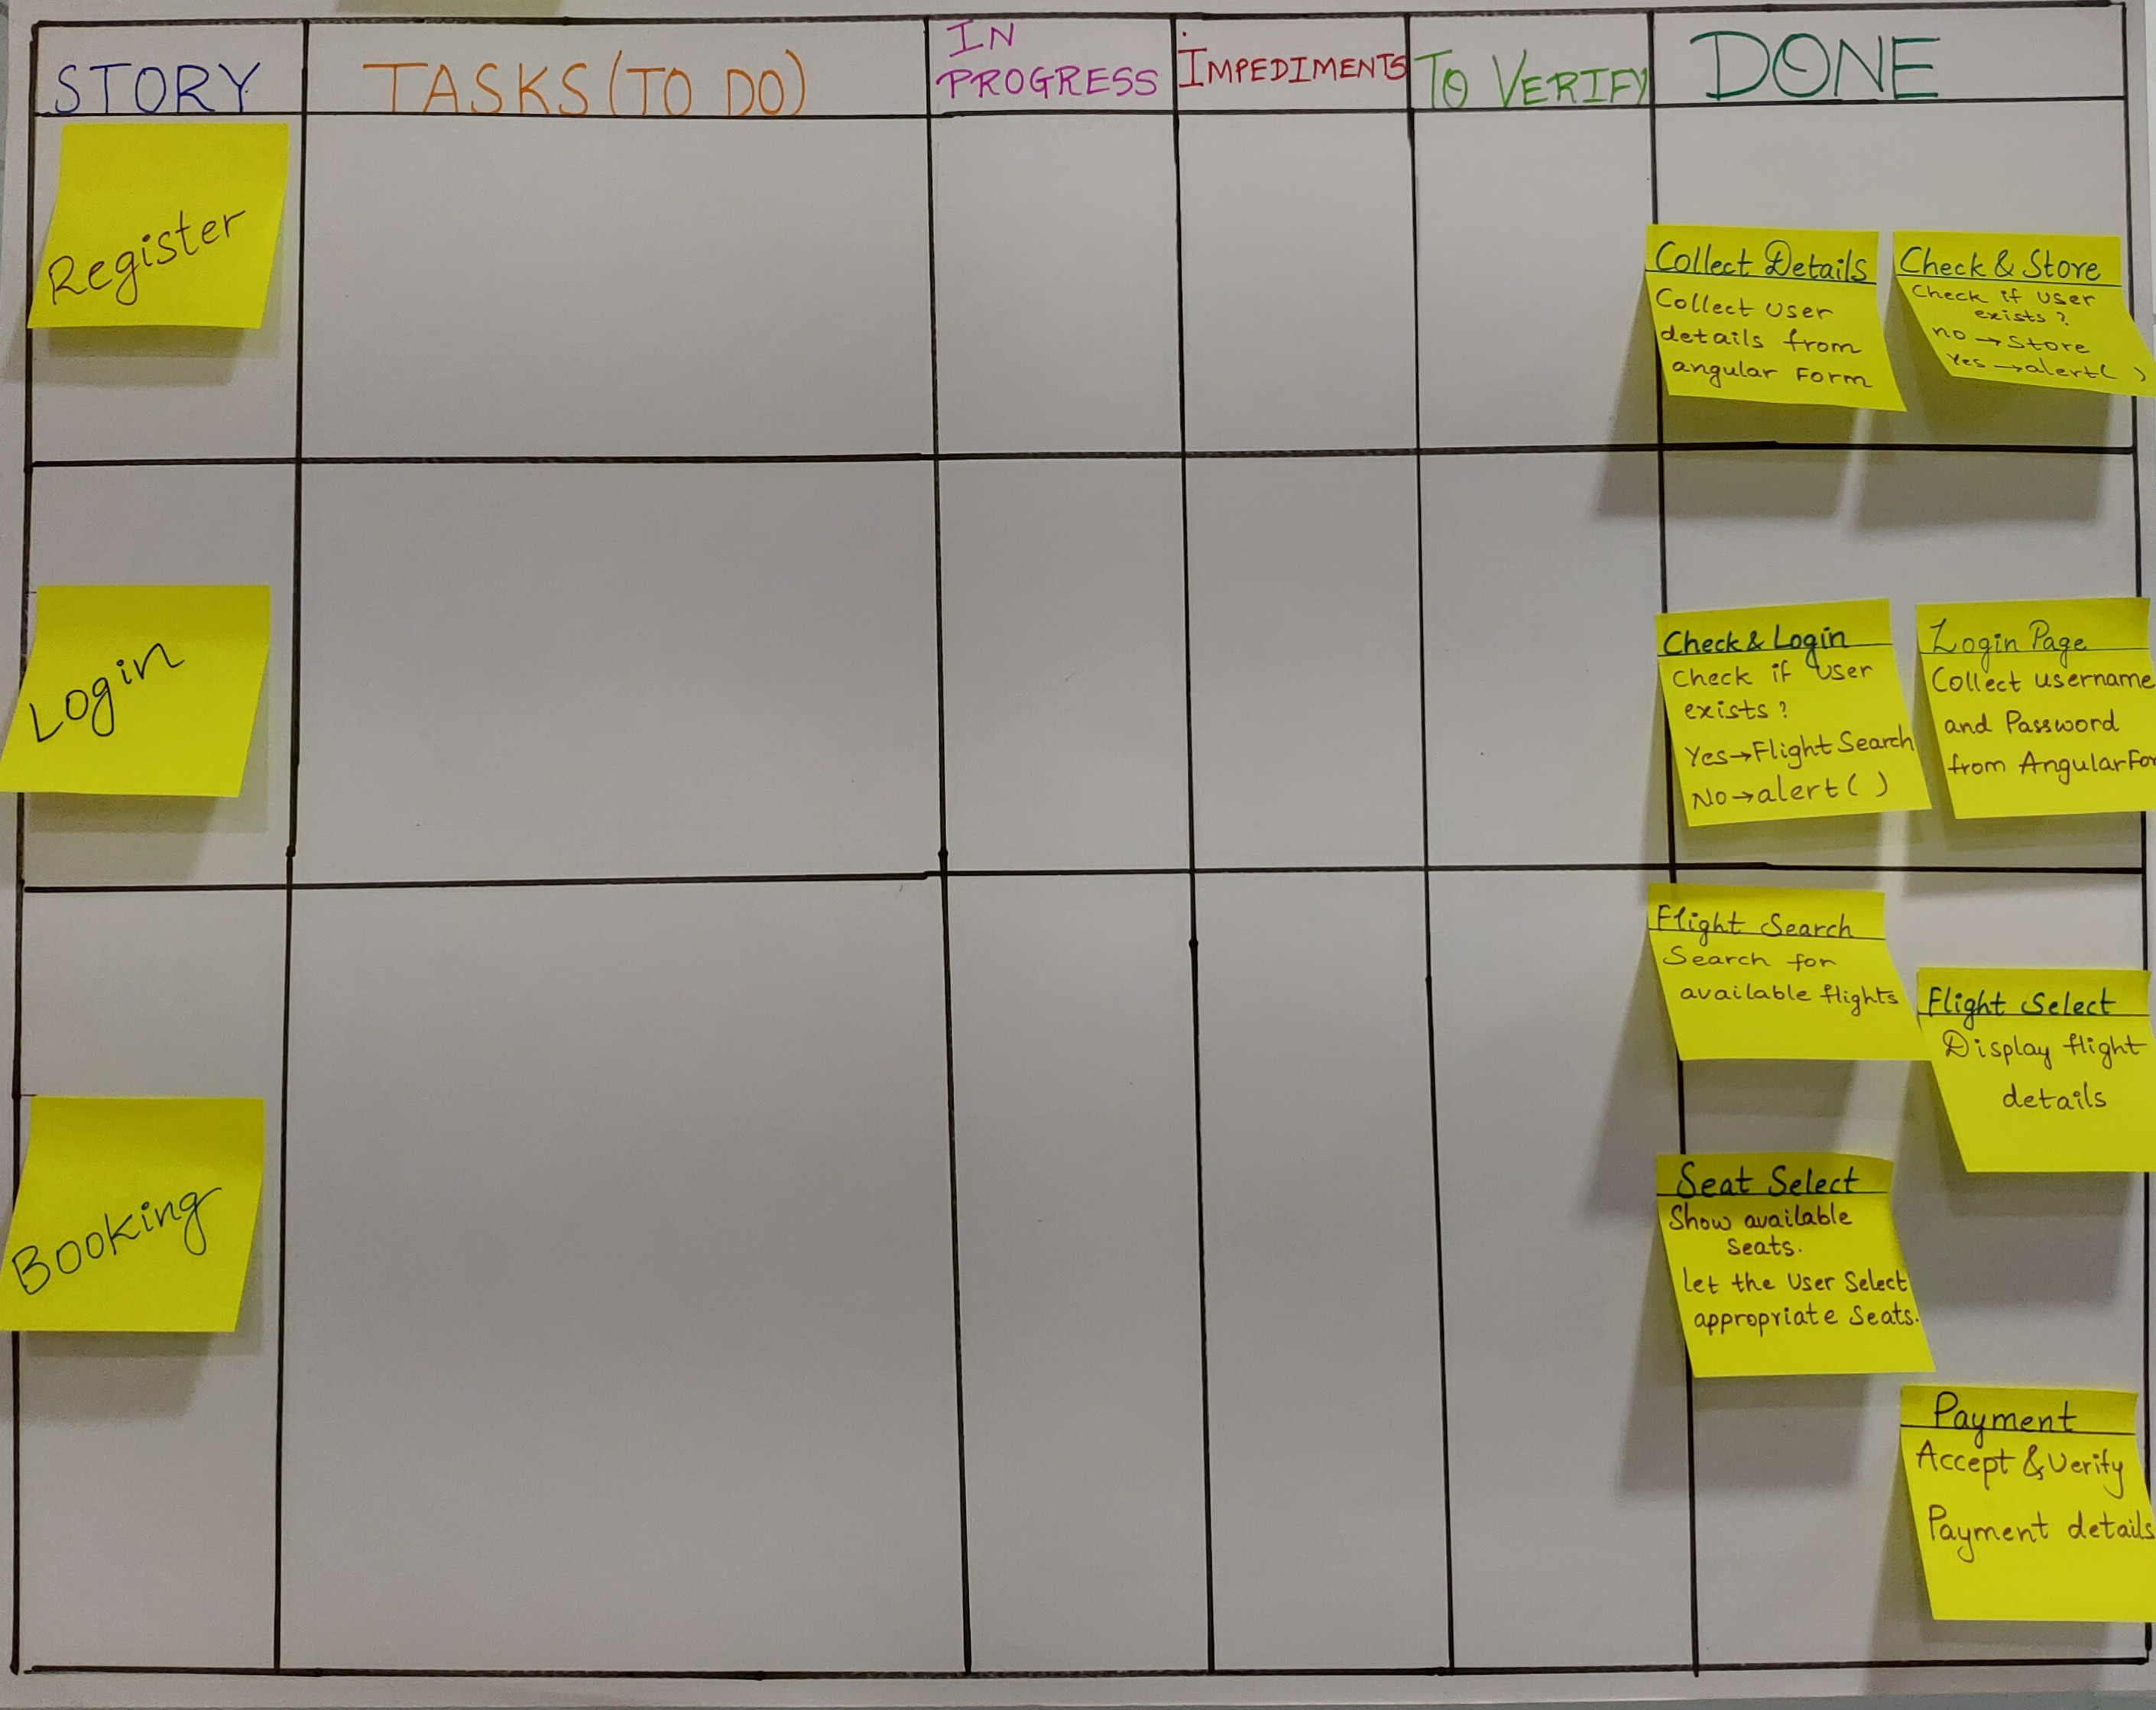
Sprint - 1 Scrum Board

Slide 14
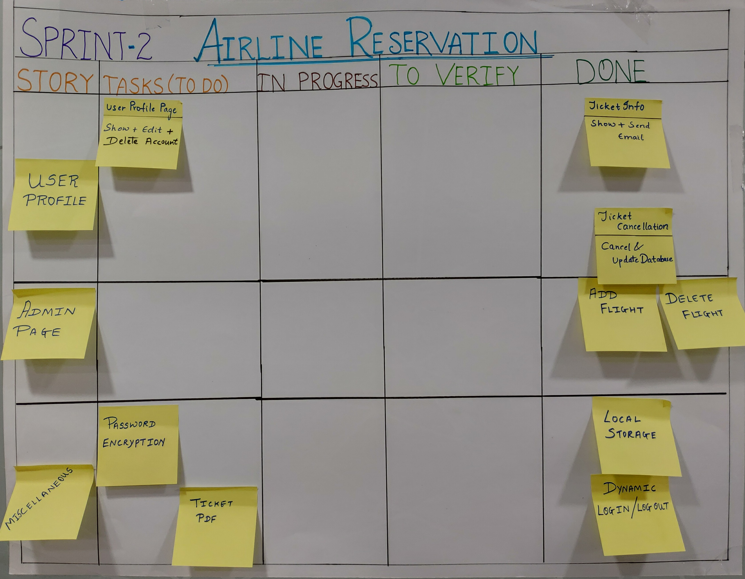
Sprint - 2 Scrum Board

